Slide 1
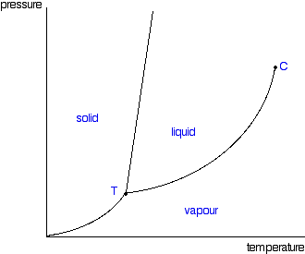

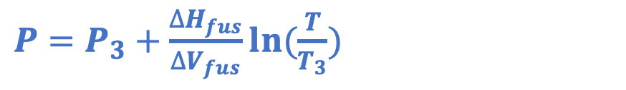
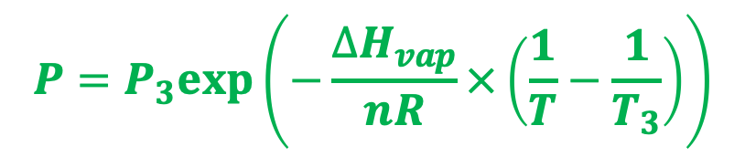
Last time: Thomson and Clausius-Clapeyron
$P=P_{3}+\frac{∆H_{fus}}{∆V_{fus}}ln⁡(\frac{T}{T_{3}})$
P
$$P=P_{3}exp⁡\left(−\frac{∆H_{vap}}{nR}×\left(\frac{1}{T}−\frac{1}{T_{3}}\right)\right)$$
T
$P=P_{3}exp⁡\left(−\frac{∆H_{sub}}{nR}×\left(\frac{1}{T}−\frac{1}{T_{3}}\right)\right)$

Slide 2
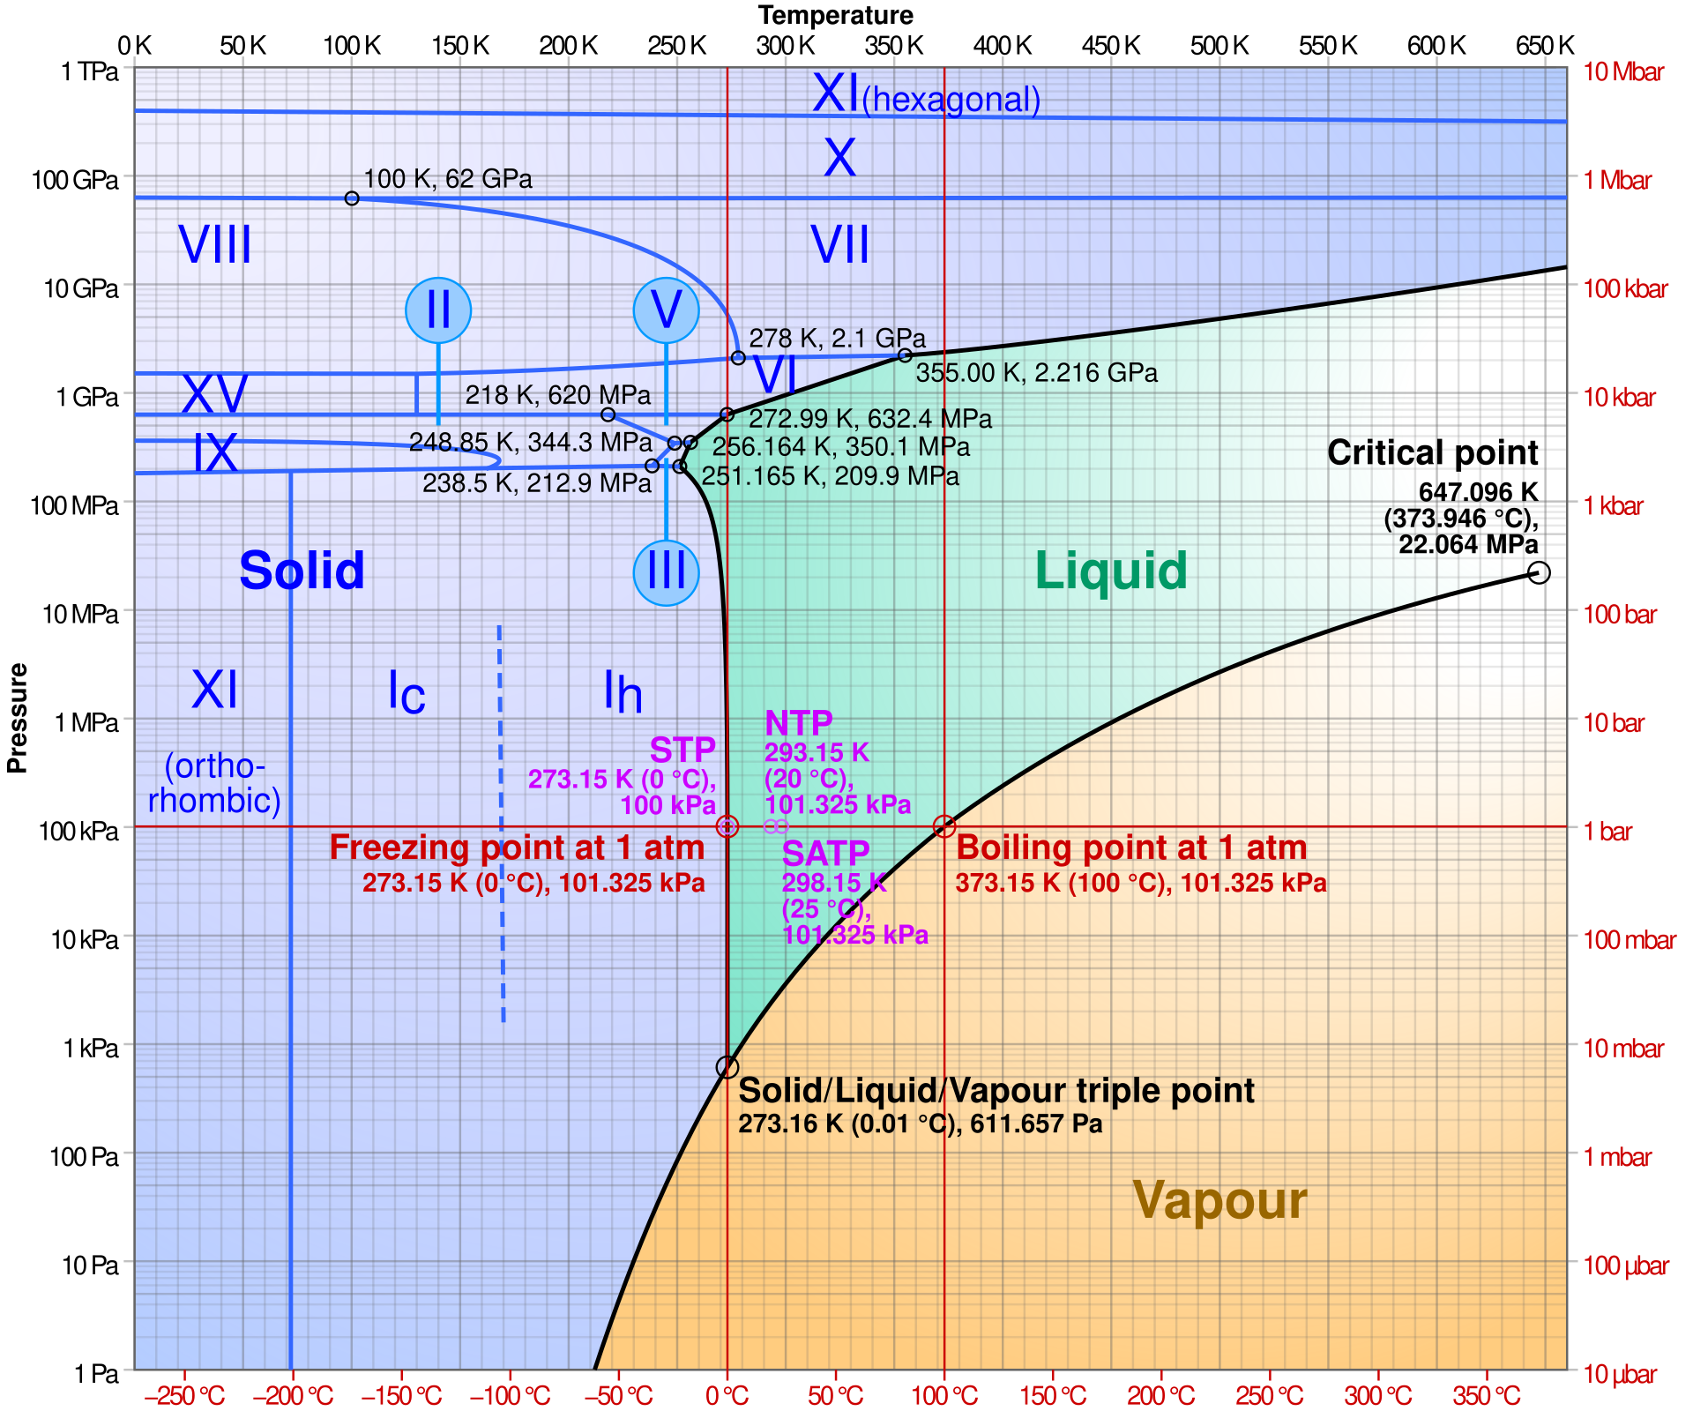
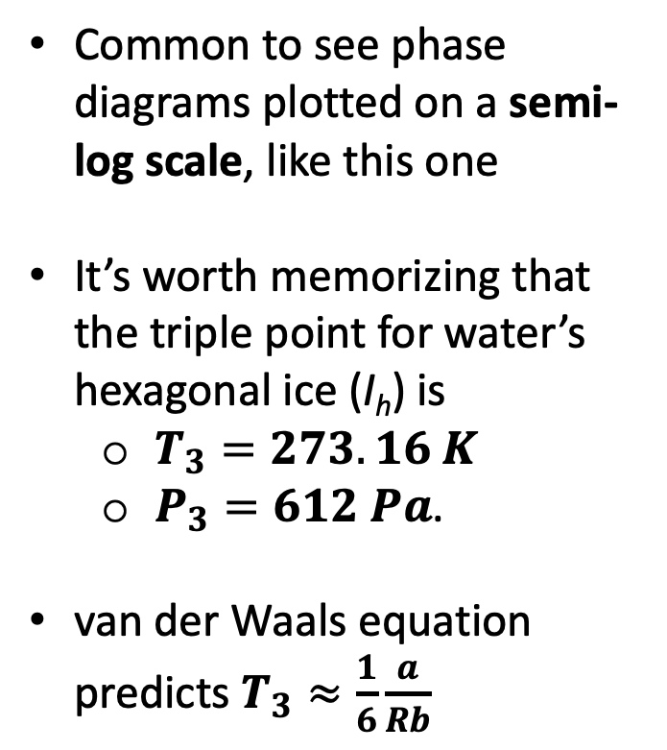
There are usually multiple solid phases, actually – and therefore multiple triple points
Common to see phase diagrams plotted on a semi-log scale, like this one
It’s worth memorizing that the triple point for water’s hexagonal ice (I_{h}) is
$T_{3}=273.16 K$
$P_{3}=612 Pa$.
van der Waals equation predicts $T_{3}≈\frac{1}{6}\frac{a}{Rb}$

Slide 3
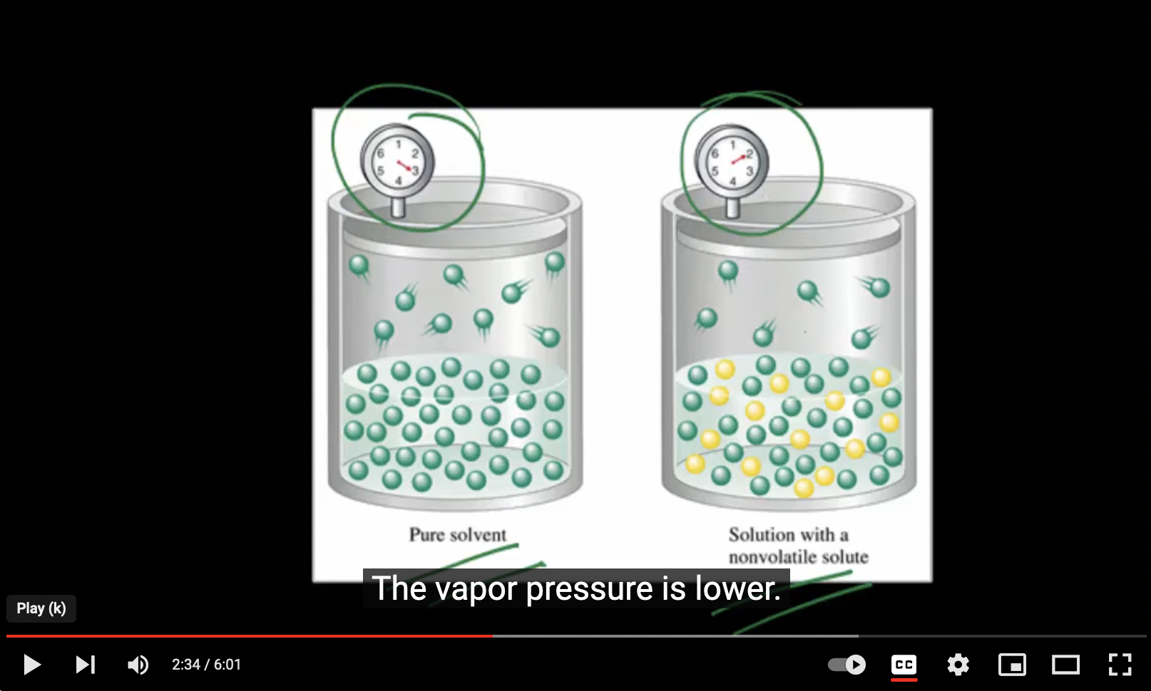
Next: when there’s solute …
https://youtu.be/jMj4txLGNG4

Slide 4

Our notation: $P_{A}^{∗}$ is the vapor pressure over pure solvent A, $P_{A}$ is when it’s a solution below
A(g)
A(g)
${P_{A}=P}_{A}^{∗}$
Equilibrium
Not in equilibrium
A
A
A
A
Add solute B
B
A
A
A
A
A
A
A
A
Solvent A with solute B
B
Pure solvent A
A
A
A
A
The vapor pressure of the gaseous form of a solvent in equilibrium with a solution ($P_{A}$) will be less than it would be above the pure solvent ($P_{A}^{∗}$).

Slide 5




Our notation: $P_{A}^{∗}$ is the vapor pressure over pure solvent A, $P_{A}$ is when it’s a solution below
P
A(g)
${P_{A}<P}_{A}^{∗}$
New equilibrium
A
$$P_{A}^{∗}$$
B
A
A
A
A
Solvent A with solute B
B
$$P_{A}$$
A
A
T
The vapor pressure of the gaseous form of a solvent in equilibrium with a solution ($P_{A}$) will be less than it would be above the pure solvent ($P_{A}^{∗}$).

Slide 6

Raoult’s Law relates $P_{A}$ to $P_{A}^{∗}$
P
A(g)
${P_{A}=P}_{A}^{∗}χ_{A}$
New equilibrium
A
$$P_{A}^{∗}$$
B
A
A
A
A
Solvent A with solute B
B
$$P_{A}$$
A
A
T
Here, $χ_{A}$ is the mole fraction of solvent A in the solution,
$χ_{A}≡\frac{n_{A}}{n_{A}+n_{B}}$. A handy formula: $χ_{A}=\frac{1}{1+M_{A}b_{B}}$ where $b_{B}≡\frac{mol B}{kg A}$ is the solute’s molality.

Slide 7


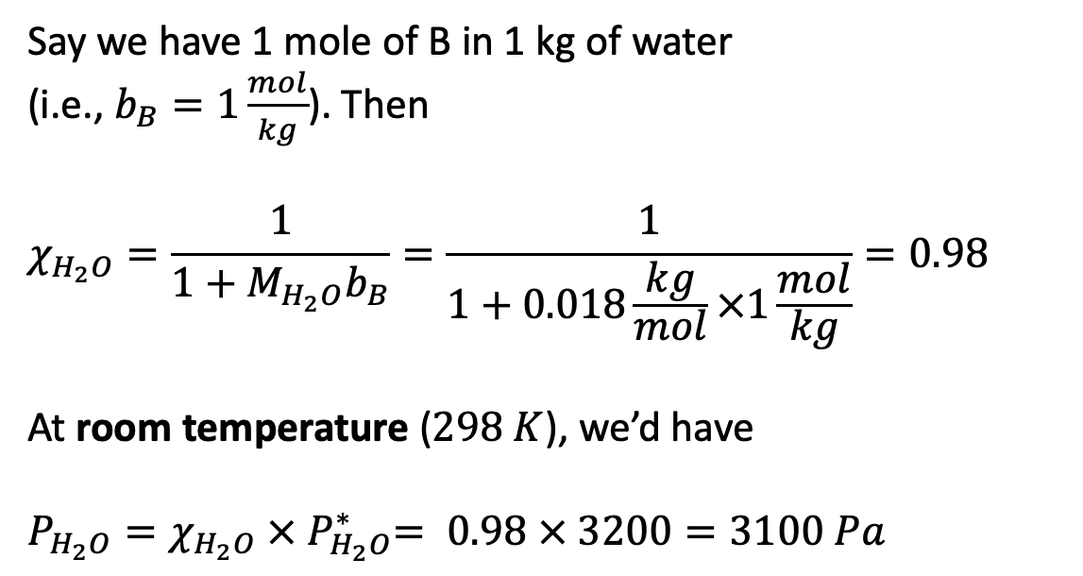
Example Raoult’s Law calculation
P
Say we have 1 mole of B in 1 kg of water
(i.e., $b_{B}=1\frac{mol}{kg}$). Then
$$χ_{H_{2}O}=\frac{1}{1+M_{H_{2}O}b_{B}}=\frac{1}{1+0.018\frac{kg}{mol}×1\frac{mol}{kg}}=0.98$$
At room temperature ($298 K$), we’d have
$P_{H_{2}O}=χ_{H_{2}O} {× P}_{H_{2}O}^{∗}= 0.98 × 3200=3100 Pa$
$$P_{A}^{∗}$$
$$3200 Pa$$
$$P_{A}$$
$$3100 Pa$$
T

Slide 8


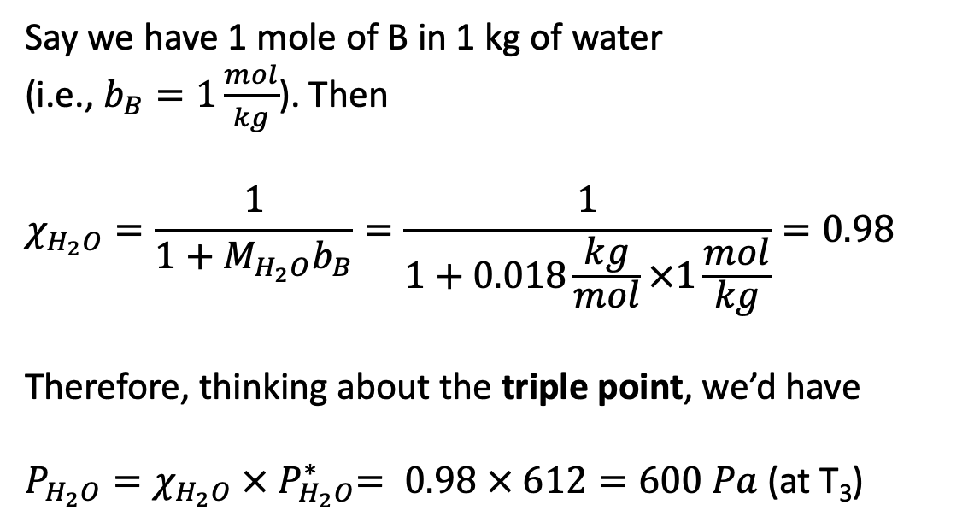


Example Raoult’s Law calculation
P
Say we have 1 mole of B in 1 kg of water
(i.e., $b_{B}=1\frac{mol}{kg}$). Then
$$χ_{H_{2}O}=\frac{1}{1+M_{H_{2}O}b_{B}}=\frac{1}{1+0.018\frac{kg}{mol}×1\frac{mol}{kg}}=0.98$$
Therefore, thinking about the triple point, we’d have
$P_{H_{2}O}=χ_{H_{2}O} {× P}_{H_{2}O}^{∗}= 0.98 × 612=600 Pa$ (at T₃)
$$P_{A}^{∗}$$
$$P_{A}$$
$$612 Pa$$
$$600 Pa$$
T

Slide 9
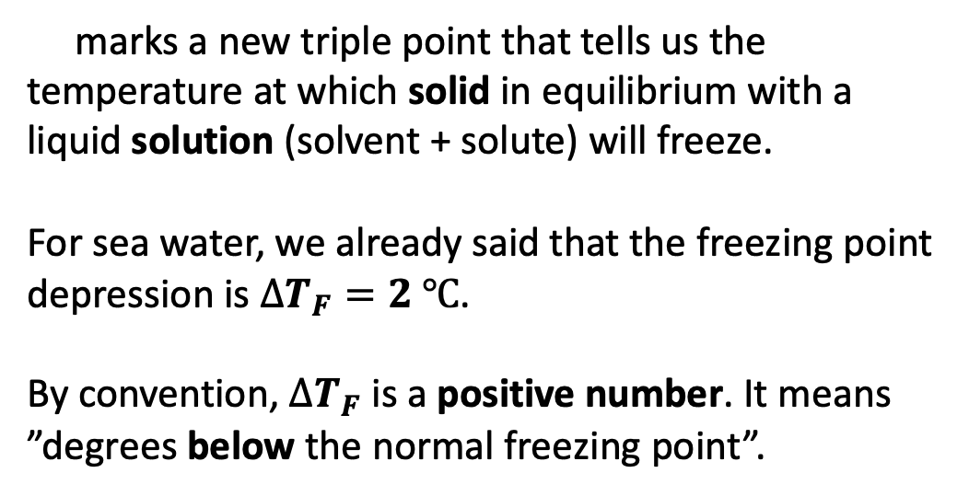

Raoult’s Law and freezing point depression
P
marks a new triple point that tells us the temperature at which solid in equilibrium with a liquid solution (solvent + solute) will freeze.
For sea water, we already said that the freezing point depression is $∆T_{F}=2 ℃$.
By convention, $∆T_{F}$ is a positive number. It means ”degrees below the normal freezing point”.
$$P_{A}^{∗}$$
$$P_{A}$$
$$∆T_{F}$$
T

Slide 10

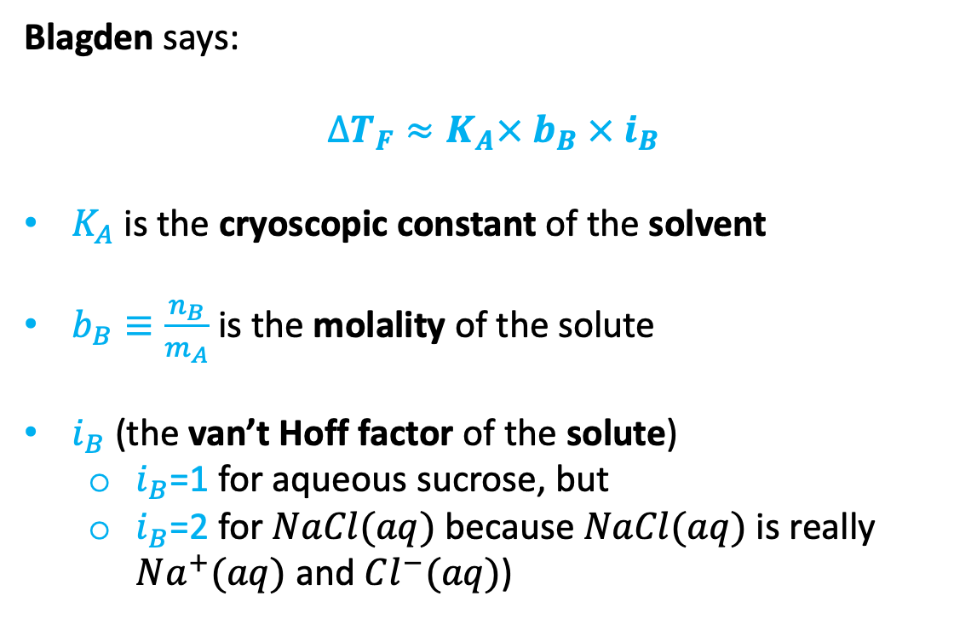
Blagden’s Law for freezing point depression
Blagden says:
$$∆T_{F}≈K_{A}× b_{B} × i_{B}$$
$K_{A}$ is the cryoscopic constant of the solvent
$b_{B}≡\frac{n_{B}}{m_{A}}$ is the molality of the solute
$i_{B}$ (the van’t Hoff factor of the solute)
$i_{B}$=1 for aqueous sucrose, but
$i_{B}$=2 for $NaCl(aq)$ because $NaCl(aq)$ is really $Na^{+}(aq)$ and $Cl^{−}(aq)$)
P
$$P_{A}^{∗}$$
$$P_{A}$$
$$∆T_{F}$$
T
Hypothesis: there’s a connection between Blagden and Raoult.
How to explore that hypothesis: use ${P_{A}=P}_{A}^{∗}χ_{A}$ to deduce $∆T_{F}≈K_{A}× b_{B} × i_{B}$.

Slide 11
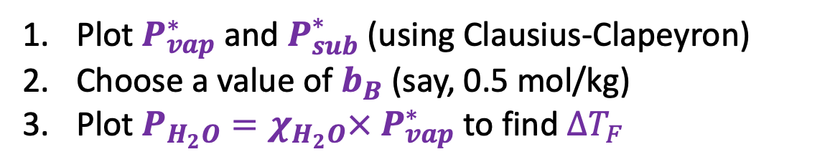
Using Raoult’s Law to deduce Blagden’s Law
P
Plot $P_{vap}^{∗}$ and $P_{sub}^{∗}$ (using Clausius-Clapeyron)
Choose a value of $b_{B}$ (say, 0.5 mol/kg)
Plot $P_{H_{2}O}=χ_{H_{2}O}×{ P}_{vap}^{∗}$ to find $∆T_{F}$
$$P_{A}^{∗}$$
$$P_{A}$$
$$∆T_{F}$$
T

Slide 12
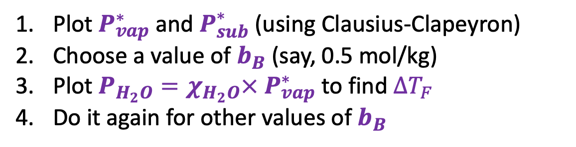
Using Raoult’s Law to deduce Blagden’s Law
P
Plot $P_{vap}^{∗}$ and $P_{sub}^{∗}$ (using Clausius-Clapeyron)
Choose a value of $b_{B}$ (say, 0.5 mol/kg)
Plot $P_{H_{2}O}=χ_{H_{2}O}×{ P}_{vap}^{∗}$ to find $∆T_{F}$
Do it again for other values of $b_{B}$
$$P_{A}^{∗}$$
$$P_{A}$$
$$∆T_{F}$$
T

Slide 13
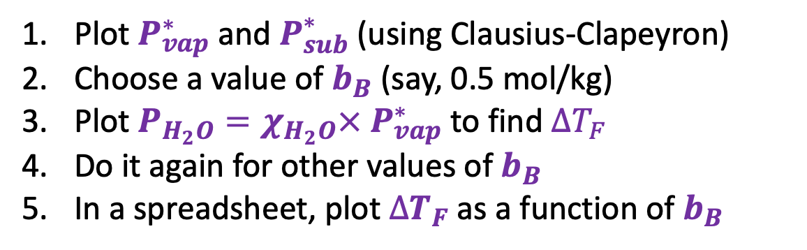


Using Raoult’s Law to deduce Blagden’s Law
P
Plot $P_{vap}^{∗}$ and $P_{sub}^{∗}$ (using Clausius-Clapeyron)
Choose a value of $b_{B}$ (say, 0.5 mol/kg)
Plot $P_{H_{2}O}=χ_{H_{2}O}×{ P}_{vap}^{∗}$ to find $∆T_{F}$
Do it again for other values of $b_{B}$
In a spreadsheet, plot $∆T_{F}$ as a function of $b_{B}$
$$P_{A}^{∗}$$
$$P_{A}$$
$∆T_{F}$
$$∆T_{F}$$
T
$$b_{B}$$

Slide 14
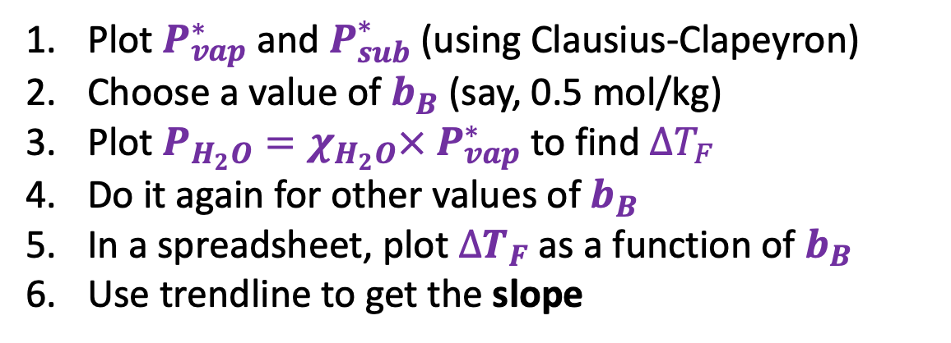
Using Raoult’s Law to deduce Blagden’s Law
P
Plot $P_{vap}^{∗}$ and $P_{sub}^{∗}$ (using Clausius-Clapeyron)
Choose a value of $b_{B}$ (say, 0.5 mol/kg)
Plot $P_{H_{2}O}=χ_{H_{2}O}×{ P}_{vap}^{∗}$ to find $∆T_{F}$
Do it again for other values of $b_{B}$
In a spreadsheet, plot $∆T_{F}$ as a function of $b_{B}$
Use trendline to get the slope
$$P_{A}^{∗}$$
$$P_{A}$$
$∆T_{F}$
$$∆T_{F}$$
T
$$b_{B}$$

Slide 15

Using Raoult’s Law to deduce Blagden’s Law
P
Plot $P_{vap}^{∗}$ and $P_{sub}^{∗}$ (using Clausius-Clapeyron)
Choose a value of $b_{B}$ (say, 0.5 mol/kg)
Plot $P_{H_{2}O}=χ_{H_{2}O}×{ P}_{vap}^{∗}$ to find $∆T_{F}$
Do it again for other values of $b_{B}$
In a spreadsheet, plot $∆T_{F}$ as a function of $b_{B}$
Use trendline to get the slope
$$P_{A}^{∗}$$
$$P_{A}$$
$$∆T_{F}≈K_{A}× b_{B} × i_{B}$$
$∆T_{F}$
$$∆T_{F}$$
T
$$b_{B}$$

Slide 16
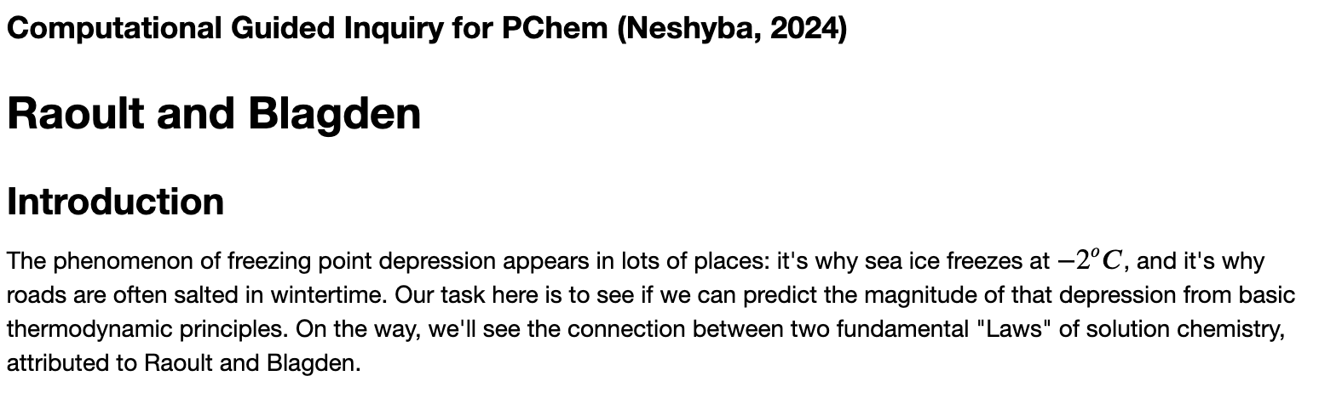
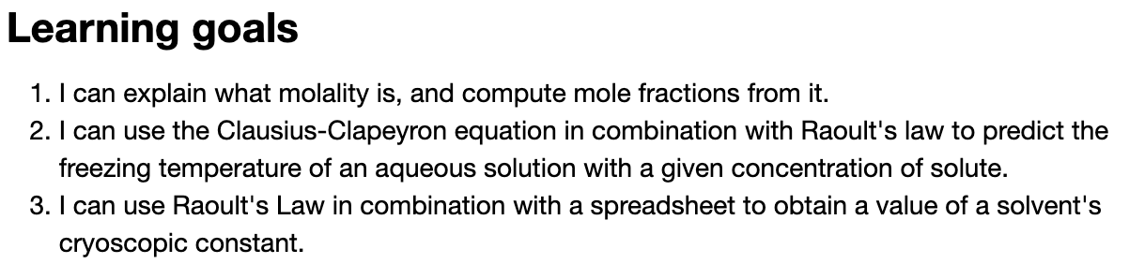
OK, let’s get started

